Slide 1
Bio211 Biostatistics and Experimental Design Winter Term 2018
Lecture 3 Experimental Design
January 12, 2018

Slide 2
Outline for today
Assignment 2 due today
Experimental design lecture
Design theoretical experiment in pairs
R check in

Slide 3
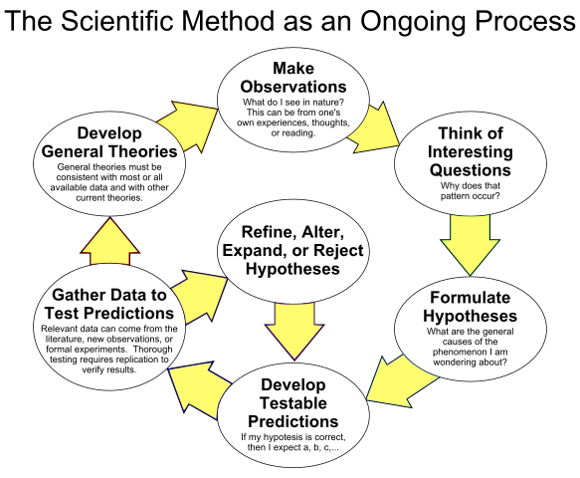
Scientific Method

Slide 4
Ask a question
What question were we asking when we performed the human physiology lab?

Slide 5
Formulate Hypotheses
Hypothesis: a proposed explanation for an observation; made in the form of a statement
Null hypothesis: the “no difference” hypothesis
Notes:
What were the hypotheses in the human physiology lab?

Slide 6
Pick your variables
Independent: What is getting manipulated?
Dependent: what is getting measured?
Control: what is staying the same?

Slide 7
Pick your variables
Independent:
Treatment: up, down, around, or stationary
Dependent: increase in heart rate, increase in breath rate
Control: 3 minutes of movement, location of experiment

Slide 8
Types of variables
Effect (independent) and response (dependent) variables
Categorical:
Male or female
Poor, average, good, great physical condition
Numeric:
Continuous: change in heart rate
Discrete: workout hours per week
Ranked:
Individuals ranked shortest to tallest but exact height unknown
Notes:
The statistical test used to analyze data depends mostly on the kinds of variables being tested and measured!

Slide 9
Types of variables
Effect (independent) and response (dependent) variables
Categorical:
Male or female
Poor, average, good, great physical condition
Numeric:
Continuous: change in heart rate
Discrete: workout hours per week
Ranked:
Individuals ranked shortest to tallest but exact height unknown
Notes:
The statistical test used to analyze data depends mostly on the kinds of variables being tested and measured!

Slide 10
Types of variables
Effect (independent) and response (dependent) variables
Categorical:
Male or female
Poor, average, good, great physical condition
Numeric:
Continuous: change in heart rate
Discrete: workout hours per week
Ranked:
Individuals ranked shortest to tallest but exact height unknown
Notes:
The statistical test used to analyze data depends mostly on the kinds of variables being tested and measured!

Slide 11
Types of variables
Effect (independent) and response (dependent) variables
Categorical:
Male or female
Poor, average, good, great physical condition
Numeric:
Continuous: change in heart rate
Discrete: workout hours per week
Ranked:
Individuals ranked shortest to tallest but exact height unknown
Notes:
The statistical test used to analyze data depends mostly on the kinds of variables being tested and measured!

Slide 12
3 Components to Experimental Design
Design of treatments: how the treatments differ and relate to each other
Design of layout: how the treatments are assigned to experimental units
Design of response: appropriate response variable to answer your question
Notes:
Valiela’s book: https://books.google.com/books?id=Ek7iBwAAQBAJ&pg=PT122&lpg=PT122&dq=unstructured+experiment+treatment&source=bl&ots=hrZyG3ixgQ&sig=OSC6_nLuHf3joB-7Re5hnEcUH6k&hl=en&sa=X&ved=0ahUKEwjLooWa7pbYAhVD0YMKHSEfCxgQ6AEIQDAD#v=onepage&q=unstructured%20experiment%20treatment&f=false

Slide 13
Design treatments
Unstructured
Structured
Factorial
 | Gender
Stair treatment | Male | Female
Up stairs
Down stairs
Around 3rd floor
Stay seated
Notes:
If all possible combinations are recorded, fully factorial
How were treatments designed in the human physiology lab?
Unstructured: haphazard assignment of experimental units to treatments based on what’s available
Structured: Purposeful assignments of experimental units to treatments

Slide 14
Design treatments
Unstructured
Structured
Factorial
 | Gender
Stair treatment | Male | Female
Up stairs
Down stairs
Around 3rd floor
Stay seated
Notes:
If all possible combinations are recorded, fully factorial
How were treatments designed in the human physiology lab?

Slide 15
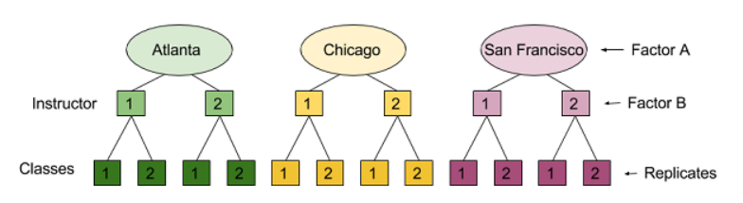
Design treatments
Unstructured
Structured
Nested
Notes:
If levels of one factor only occur within one level of the other factor

Slide 16
Design treatments
Unstructured
Structured
Gradient
Change in heart rate
Workout hours per week

Slide 17
Design layout
Randomization: aims to reduce or eliminate bias
Make sure that each experimental unit is equally likely to be assigned to one treatment or another
Notes:
How to randomize with excel/R?

Slide 18
Design layout
Replication: assigning more than one experimental unit to a treatment
Control for random variation
Obtain more representative measure of a population
Measure with-in group variation
Notes:
What was the replication in the human physiology lab? Was it enough?

Slide 19
Design Response
Appropriate response variable to answer your question
What is getting measured?

Slide 20
Assigning significance: P values
Probability that the null hypothesis is true
α is the threshold for the p-value, below which we reject the null hypothesis and call the result “statistically significant”
Traditionally set at 0.05
5% chance the “no difference” hypothesis is true

Slide 21
Type I & Type II Errors
 | H₀ True | H₀ False
Support H₀ (p>α) | H₀ properly supported | Type II Error
Reject H₀ (p<α) | Type I Error | H₀ properly rejected

Slide 22
Type I & Type II Errors
 | H₀ True | H₀ False
Support H₀ (p>α) | H₀ properly supported | Type II Error
Reject H₀ (p<α) | Type I Error | H₀ properly rejected
Increasing α will makes Type I errors more likely (and Type II errors less likely), while decreasing will have the opposite effect.

Slide 23
Try it!
Ask a question
Generate hypotheses
Pick dependent, independent, and control variables
Design experiment

Slide 24
R!
Does everyone have RStudio downloaded and installed?
Can everyone set the working directory and read in files?
Accessing different parts of data frames
Accessing packages
Notes:
Make sure the sampling board data file is read in!!!

Slide 25
Summary
No lab today (Friday)
Assignment 3: Intro to R due before lecture on Monday

